Slide 1
Predicting power output based on weather conditions on wind Turbine Team Members: Sai Shashank Turlapati Sai Sheshank Gaddam Revanth Sai Alampally Sanjeeth Reddy Thirumalareddy Priyatham Bikumalla

Slide 2
Objective
This project is aimed at developing a Predicting power output based on weather conditions on wind turbine, demonstrates a promising capability of reducing the uncertainties in the power curve model.
Accurate and reliable wind power predictions are necessary to optimize the integration of wind power into existing electrical systems.

Slide 3
Introduction
The system should be validated with observations including wind speed and power output over a six-month period for some turbine sites at different places wind farm in various places. The results show that the tuned WRF model is able to provide hub-height wind speed prediction for the target area with reliability to some extent.

Slide 4
Problem statement
The rapid development of wind energy in many countries and the associated high uncertainties and fluctuations in power generation present a big challenge for both wind power generators and electric grids.

Slide 5
Modules
Importing the data into python
Data cleaning
Data splitting
Training data
Model evaluate
Testing data
Prediction of data

Slide 6
INPUTS AND OUTPUT Variables:
OUTPUT
Theoretical_Power_Curve (KWh)
INPUT:
LV ActivePower (kW)
Wind Speed (m/s)

Slide 7
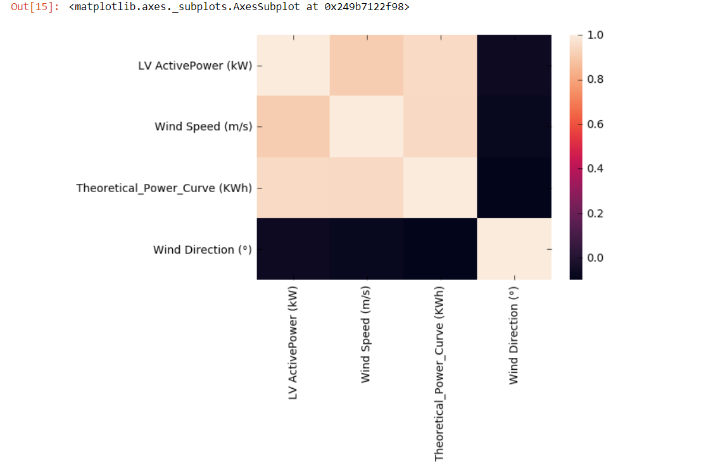
Visualisation

Slide 8
Technical Description
As the target variable i.e., Theoretical_Power_Curve (KWh) is a continuous (numerical) attribute and that too all of with different values. Hence, Regression model has to be used to get the accuracy of the model.
Also it contains more than one variable as prediction (input) we used Polynomial Regression.

Slide 9
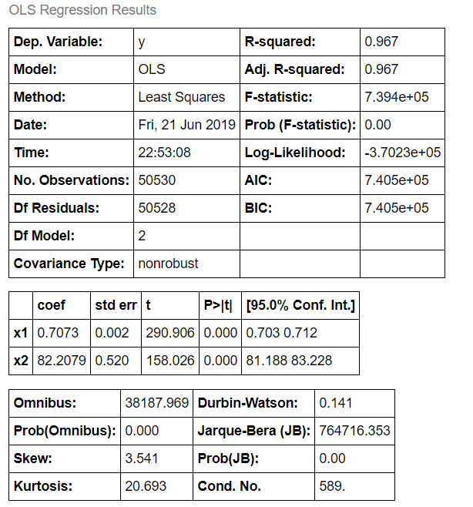
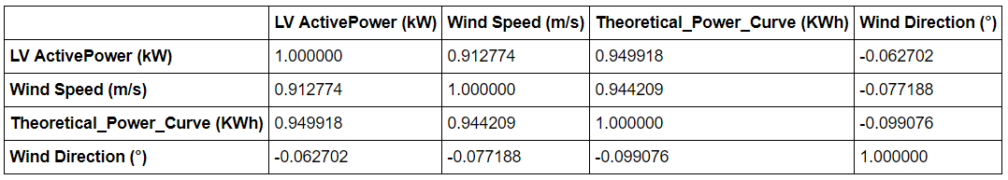
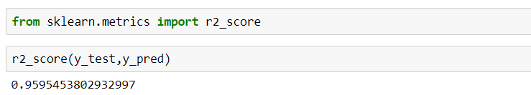
Important Code Snippets

Slide 10
The above is the correlation table. As we can observe that the magnitude is high between the Theoretical Power which is the out put & the LV Active Power. The second high is with the Wind speed. And there is a very less between the Wind direction. Hence only the LV Power and Wind speed are considered as inputs.
R-squared - explain the amount of varience of the model. As for the good model it should be high, we got 0.967.
Adjusted Rsquare - Goodness of fit(). We got it as 0.967 which is almost high. Hence this is a good model.
p>[t] - Probability Test. Since it is < 5% Alpha (0.05) then REJECT Null Hypothesis. Since, there is a significant relation between the attributes.

Slide 11

The UI

Slide 12
conclusion
This power prediction is useful for the Energy Traders & Decision makers. They can get a conclusionon following things by the power output:
At which location they can plant these wind mills.
How much supply of power can be given to a city near by the plants.
Systematic validations regarding both wind speed and power output were carried out against the observations for the target wind farm, which show that the hybrid power forecasting system presented in this paper can be an effective and practical tool for short-term predictions of wind speed and power output in various areas.

Slide 13


